Slide 1


Stephanie’s Creations: Sprint 3 Review
Team 5:
Hannah Clark | Heather Siler | Lauren Geis
Notes:
Presenter: Heather
Transition to next Presenter: NA

Slide 2

Sprint 4 Introduction
Sprint Highlights
Platform Introduction
Technical Documentation
Training Manual
Notes:
Presenter: Heather
Transition to next Presenter: NA this slide

Slide 3
Sprint Highlights
Product & Sprint Backlog Review
Burndown & Utilization Review
Notes:
Presenter: Heather
Transition to next Presenter: NA this slide

Slide 4
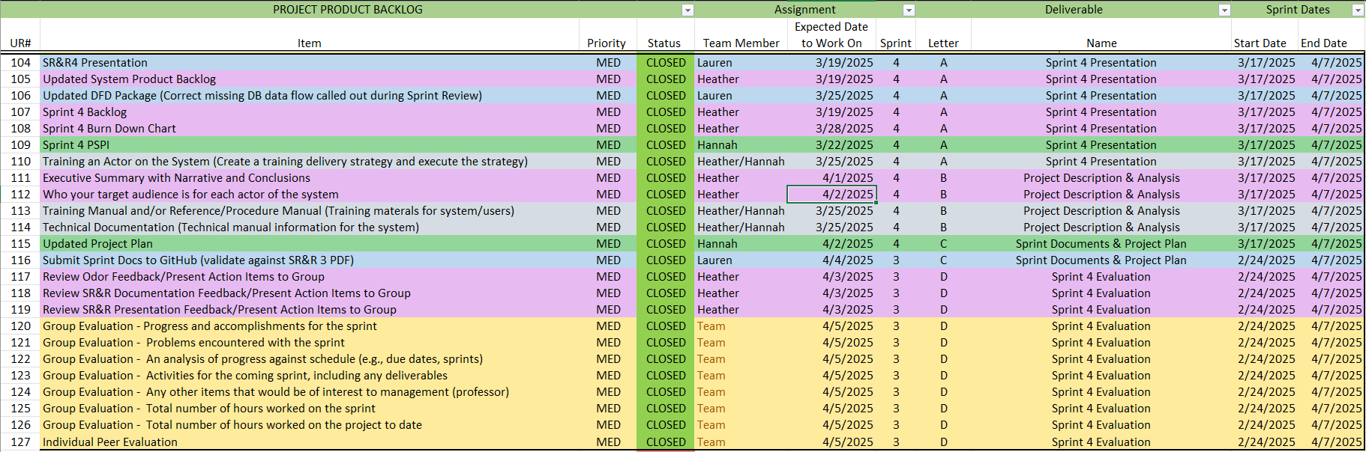
Notes:
Presenter: Heather
Transition: NA
Sprint 4 was all about Stephanie and her business. Our team is confident that the IS we are creating will save time and increase profits for our client. Now it is time to create that same level of confidence for Stephanie so that once the system is implemented she can enjoy these benefits with ease.
As we have learned during our MIS studies at ECU, people are a central and essential component of any Information System. As a result, we spent Sprint 4 focusing on Stephanie as the end user to ensure she will be able to effectively leverage the tools we have built for her business.

Slide 5
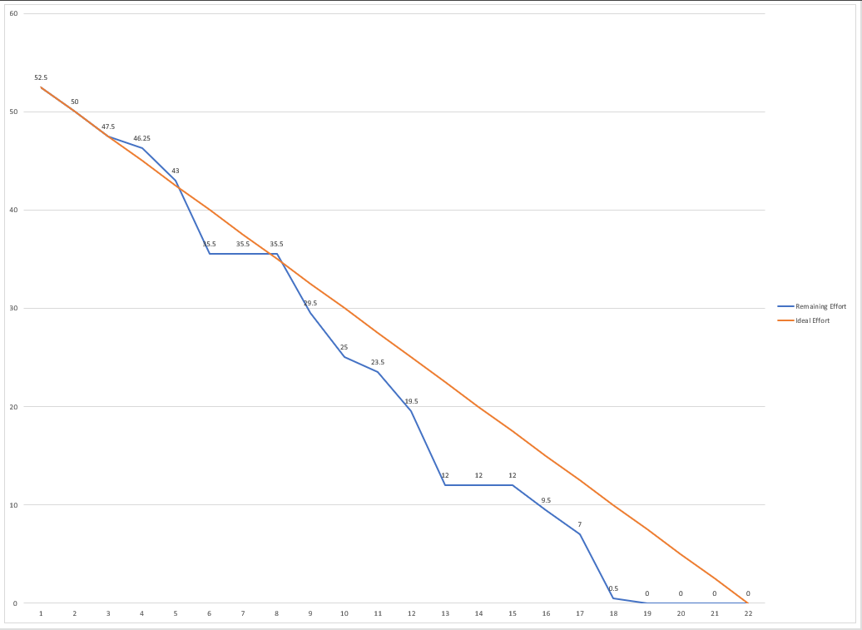
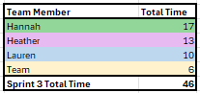
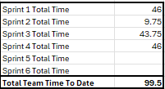
Notes:
Presenter: Heather
Transition to next Presenter: Hannah

Slide 6
Platform Introduction
Notes:
Presenter: Hannah
Transition to next Presenter: NA this slide

Slide 7
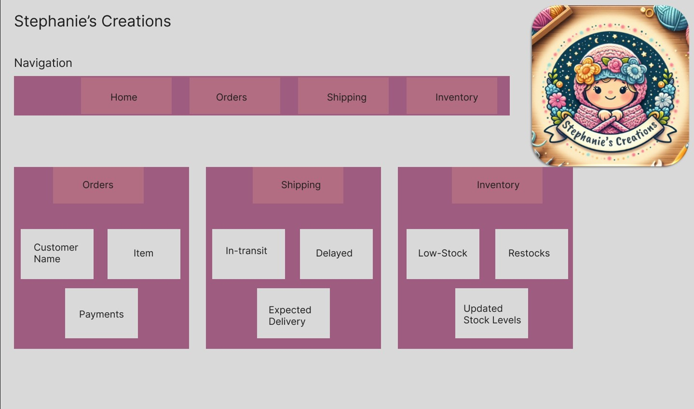
Sprint 3 PSPI
Notes:
Presenter: Hannah
Transition to next Presenter: NA this slide

Slide 8
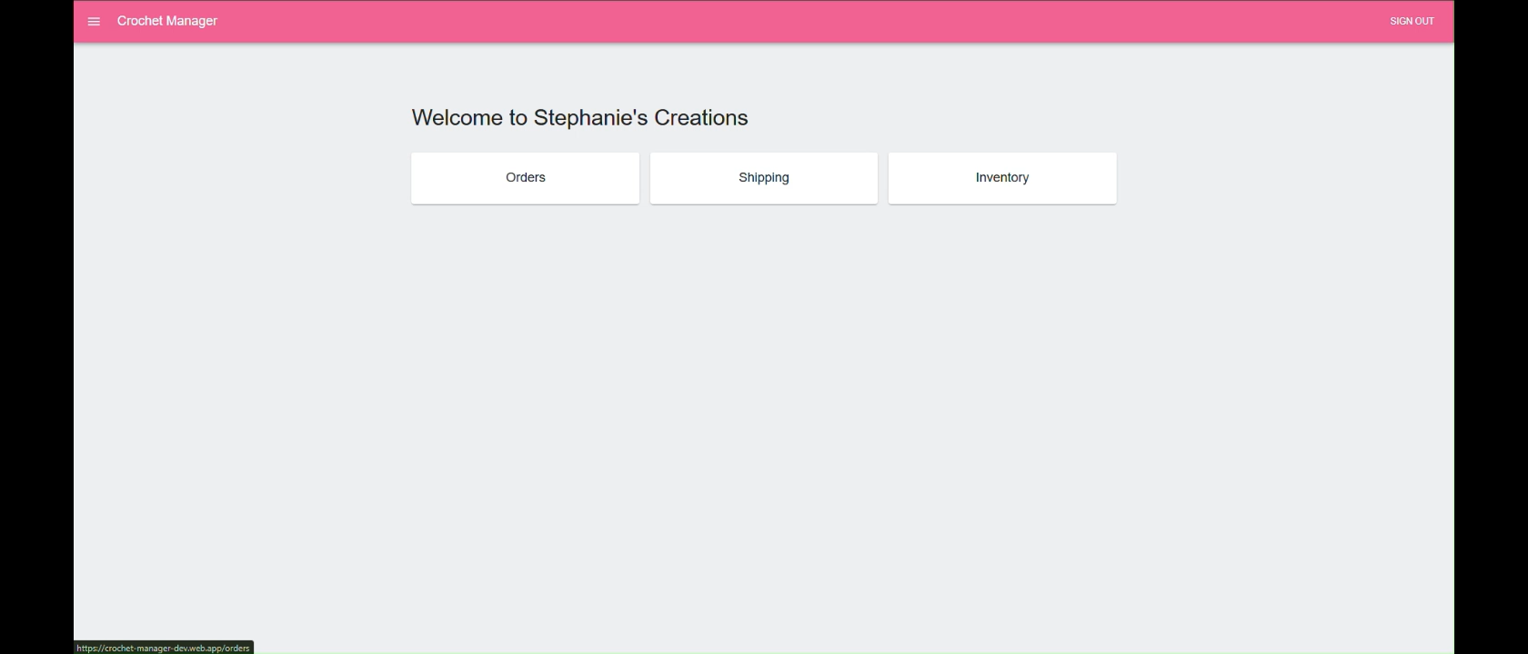
Sprint 4 PSPI
Notes:
Presenter: Hannah
Transition to next Presenter: NA this slide

Slide 9
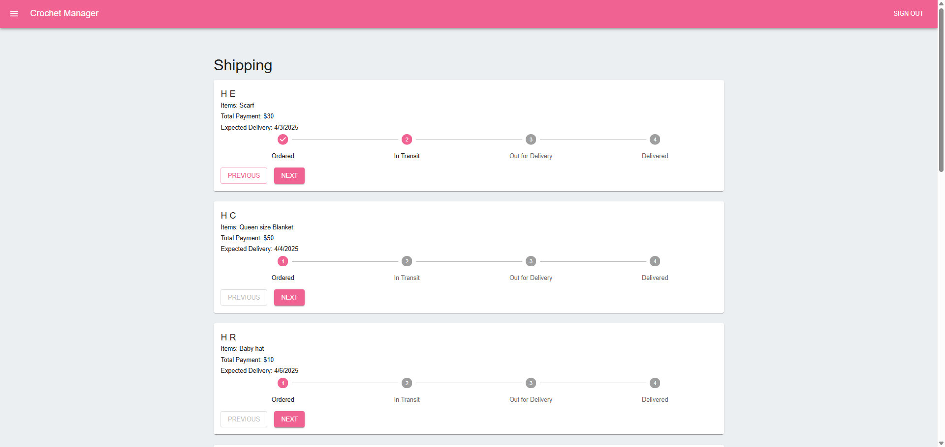
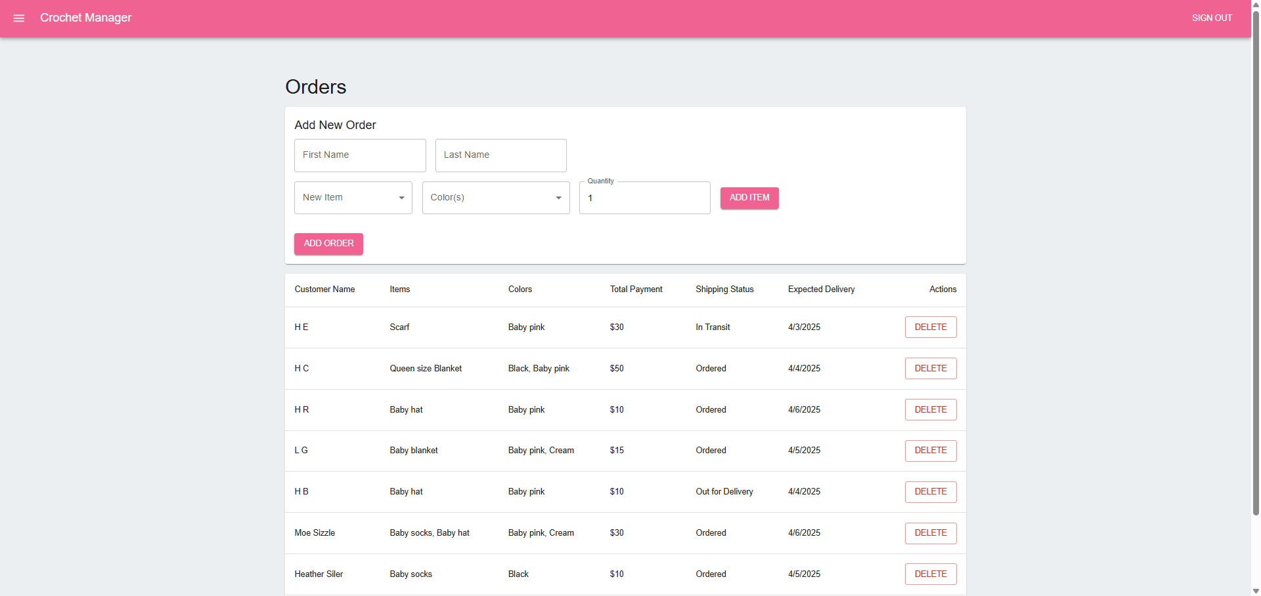
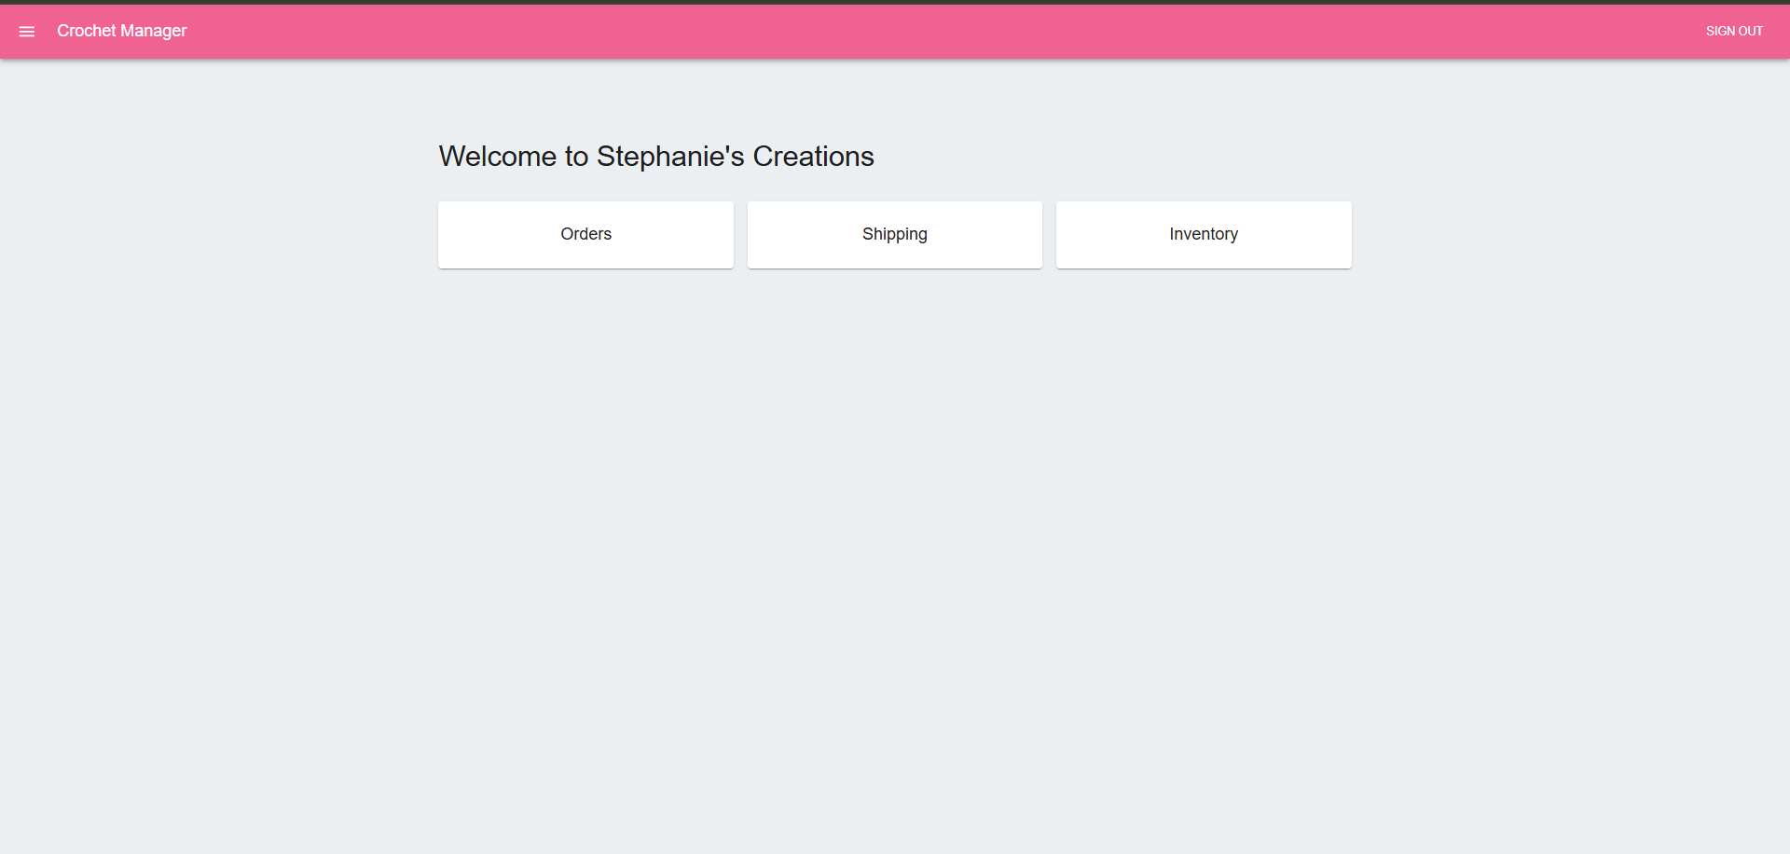
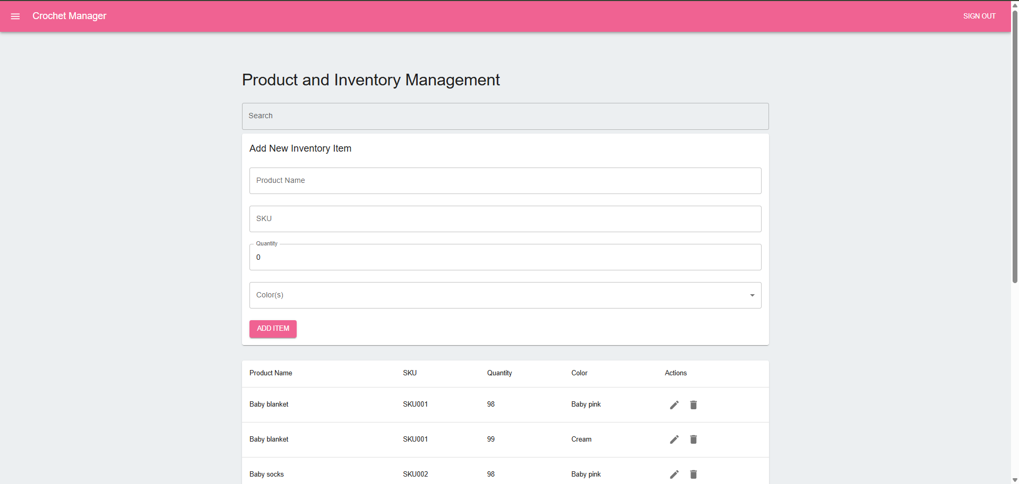
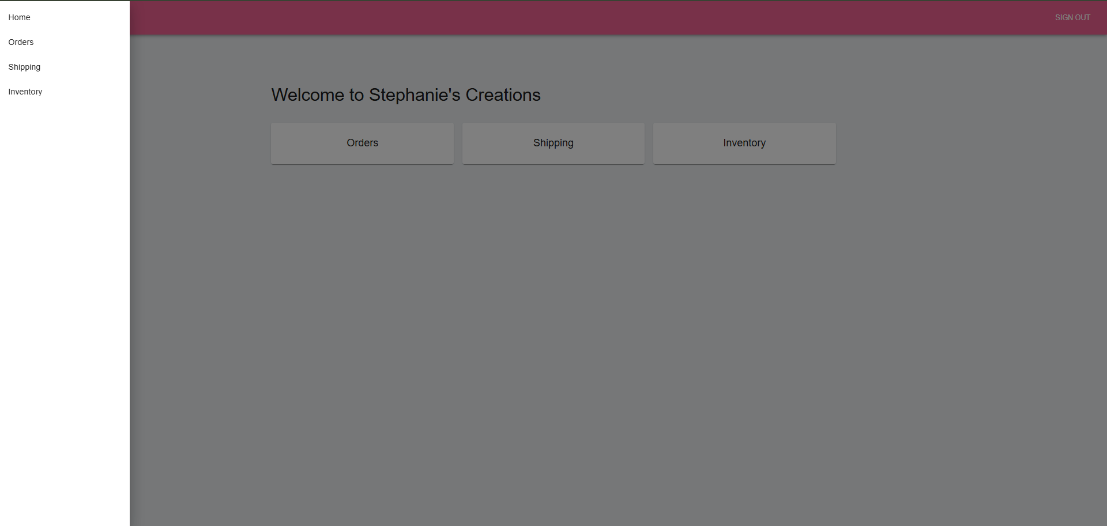
Notes:
Presenter: Hannah
Transition to next Presenter: Hannah

Slide 10
Technical Documentation
Troubleshooting
Maintenance
Code Repository
Notes:
Presenter: Hannah
Transition to next Presenter: NA this slide

Slide 11

Troubleshooting
Common issues
Non-Routine
Authentication & User Management
Order Management
Inventory Management
Shipping Management
Data Corruption
System Performance
Security Breaches
3rd Party Integration
Notes:
Presenter: Hannah
Transition to next Presenter: NA this slide

Slide 12

Maintenance
System Updates & Patch Management
Proactive strategy to maintain security, stability and performance
Patch Prioritization, Testing & Validation, Rollback
Includes detailed information explaining patch:
Sources
Deployment
Testing
Documentation
Monitoring
Verification
Security
Automation
Notes:
Presenter: Hannah
Transition to next Presenter: NA this slide

Slide 13

Code Repository
The system's source code is managed using Git version control and hosted on GitHub.
This repository facilitates collaborative development, version control, and automated deployments.
The primary purpose is to track changes, enable code reviews, and provide a reliable backup of the system's codebase.
Repository URL: https://github.com/StephanieCreations/e-commerce-system.git
Repository Structure:
backend/: FastAPI backend code
frontend/: React application for the UI
database/: Firebase Firestore rules, JSON schemas
docs/: Contains project documentation.
deploy/: Ansible playbooks and deployment scripts
Naming Conventions:
Branches: feature/<feature-name>, bugfix/<issue-number>, hotfix/<issue-number>, release/<version-number>.
Files: snake_case for Python, camelCase for JavaScript.
Notes:
Presenter: Hannah
Transition to next Presenter: NA this slide

Slide 14
Training Manual
Notes:
Presenter: Lauren
Transition to next Presenter: NA this slide

Slide 15

Notes:
Presenter: Lauren
Transition to next Presenter: NA this slide

Slide 16

Any Questions?

